Slide 1
Medium-Fi Prototype
Rachel J and Esther G

Slide 2
Mission/
Value Proposition
“Make voice interaction work for you!”
Make voice interaction easier to manage, track, and customize
Help guests communicate properly with others’ voice assistants
Notes:
Value proposition: “Make voice interaction work for you!”
Mission statement: make voice interaction easier to manage, track, and customize for people that own smart devices. In addition, we want people that are visiting others with smart devices to be able to communicate properly with their voice assistants.

Slide 3
Problem/
Solution Overview
People want to be flexible in how they interact with their smart devices
Our app allows you to:
Keep track of your devices
Define your own commands
Share information about your devices with others

Slide 4
Task 1: Share my commands (complex)
Text your personalized commands list for the Living Room Alexa to someone named Rachel J
Notes:
Note: we did not make any changes to the tasks themselves from the low-fi prototype assignment. We merely reduced the number of tasks from 6 to 3.

Slide 5
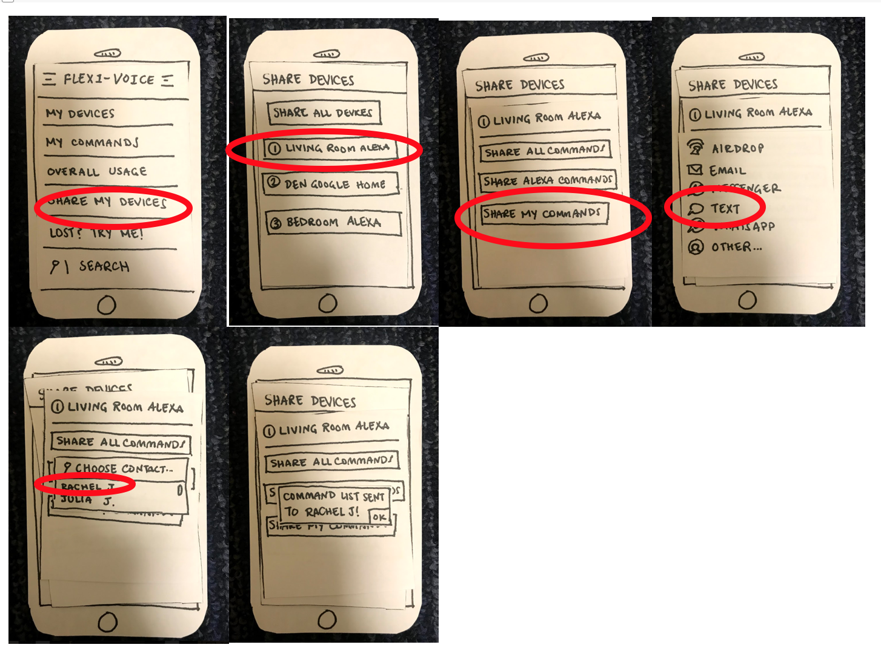
Old Interface

Slide 6
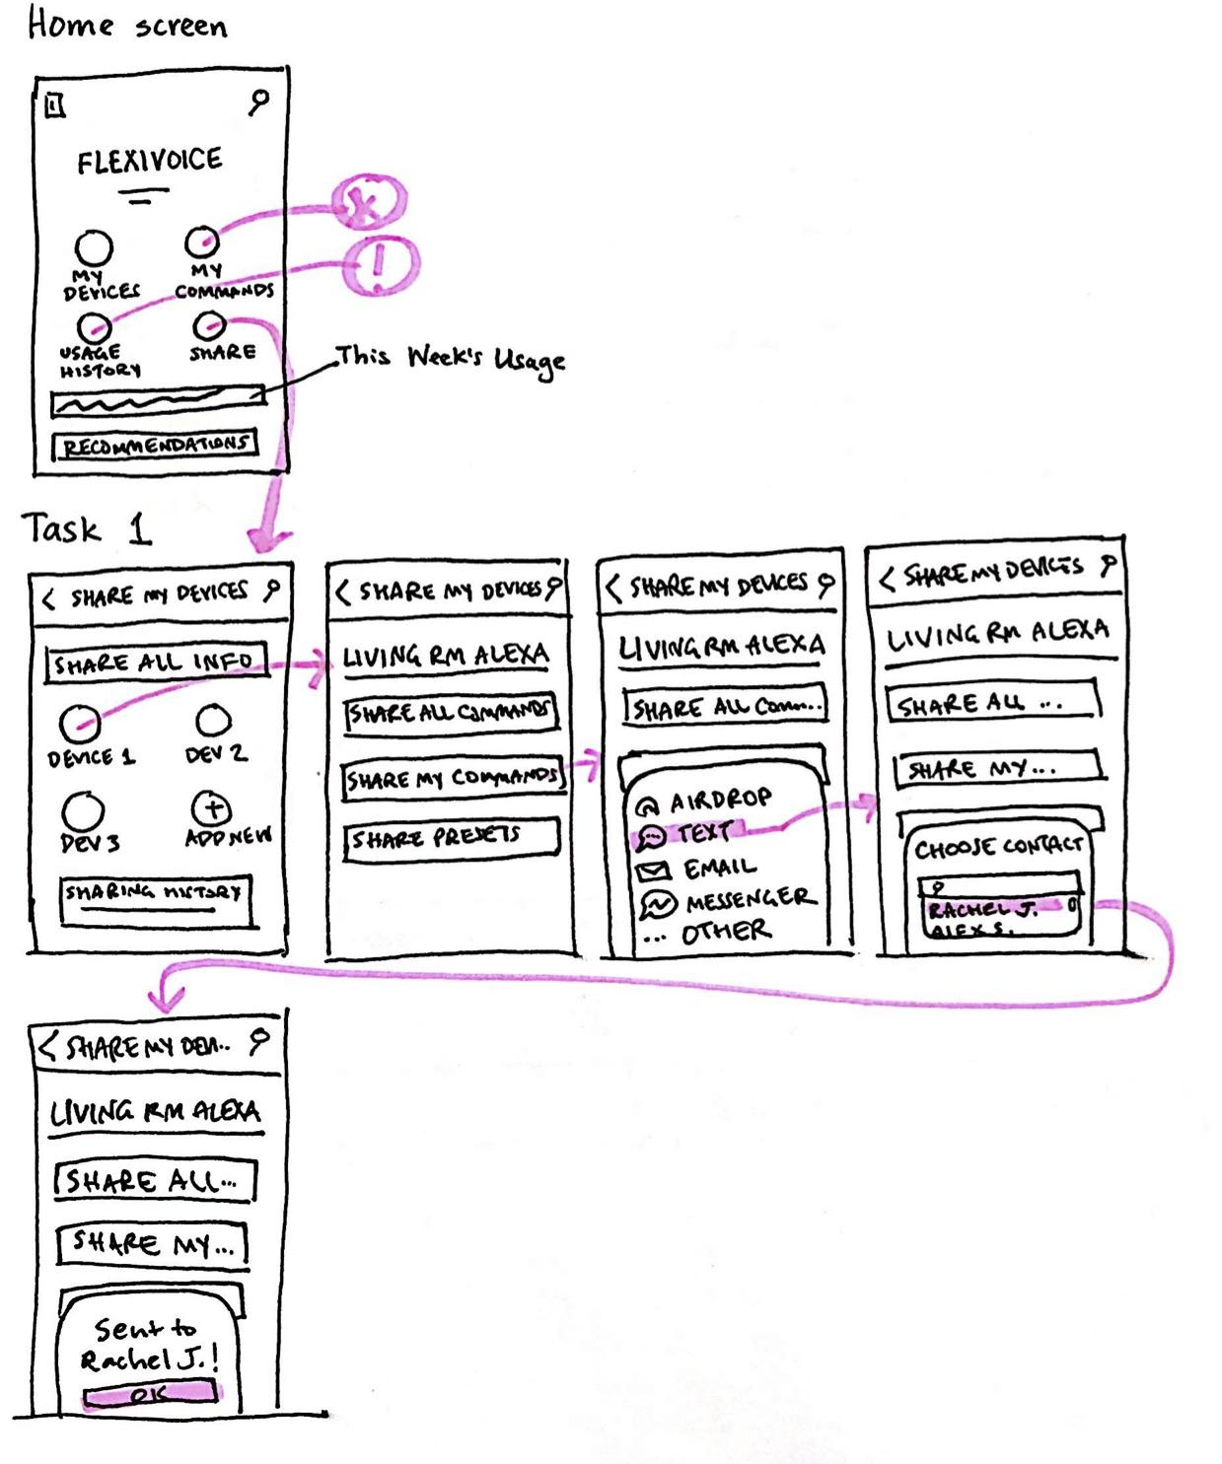
New Interface

Slide 7
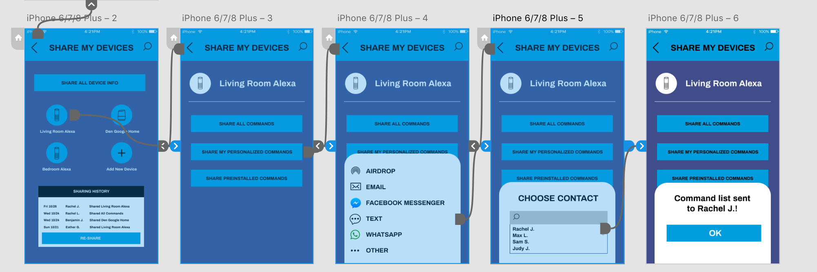
Medium-Fi Task Flow

Slide 8
Changes from Low-Fi Prototype
Put devices in a grid format
Added sharing history
Changed wording: Share My Commands to Share My Personalized Commands and Share Alexa Commands to Share Preinstalled Commands
Why? Make choices more clear
Notes:
We put the devices in a grid format to make the information more digestible.
We added sharing history to inform the user of whom they’ve already shared devices with.
We changed some of the wording on the Living Room Alexa screen to make it more clear which options you have when sharing commands.

Slide 9
Task 2: Add a command (medium)
Add a new personalized command to your Google Home, changing the command from "Google, turn on my Apple TV" to "Google, turn on my TV"

Slide 10
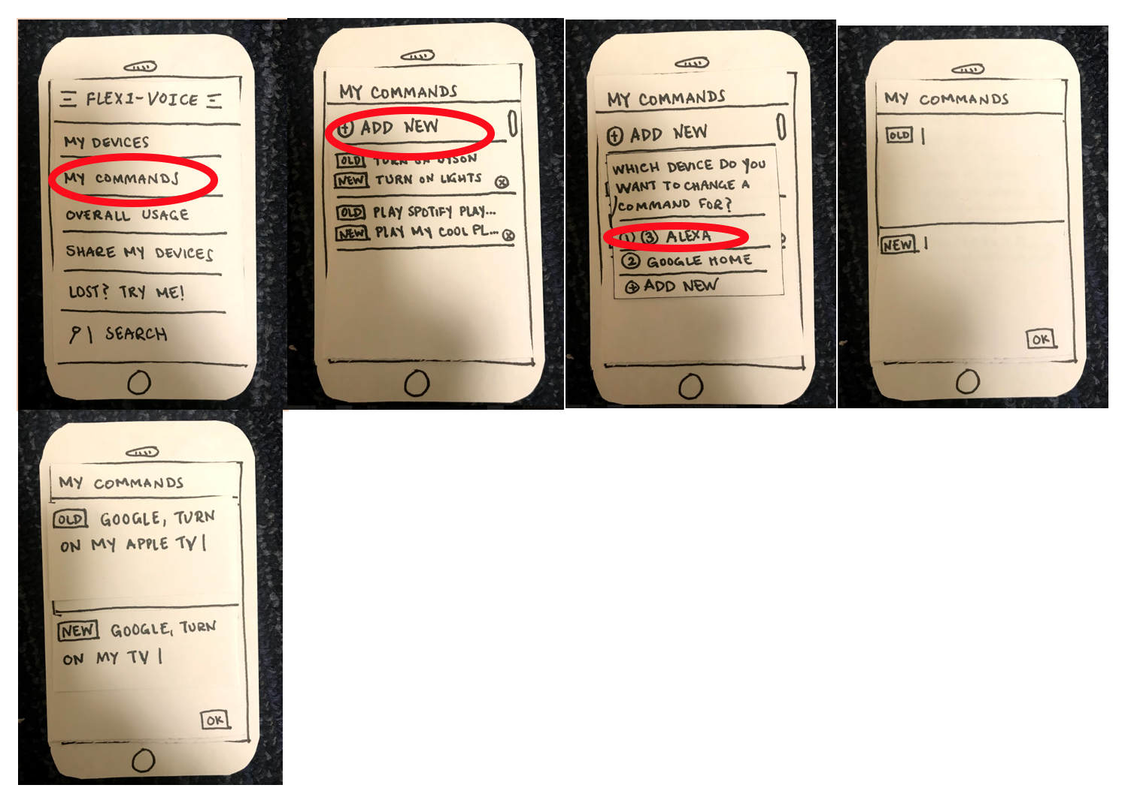
Old Interface

Slide 11
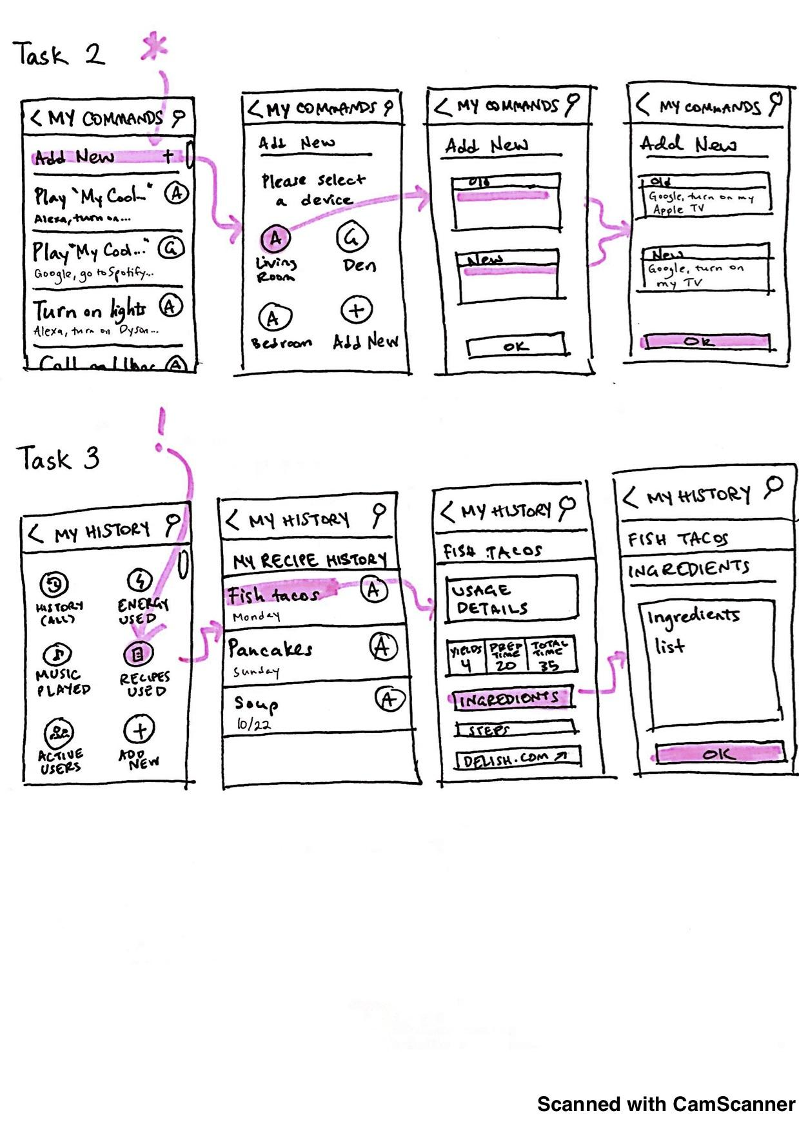
New Interface

Slide 12
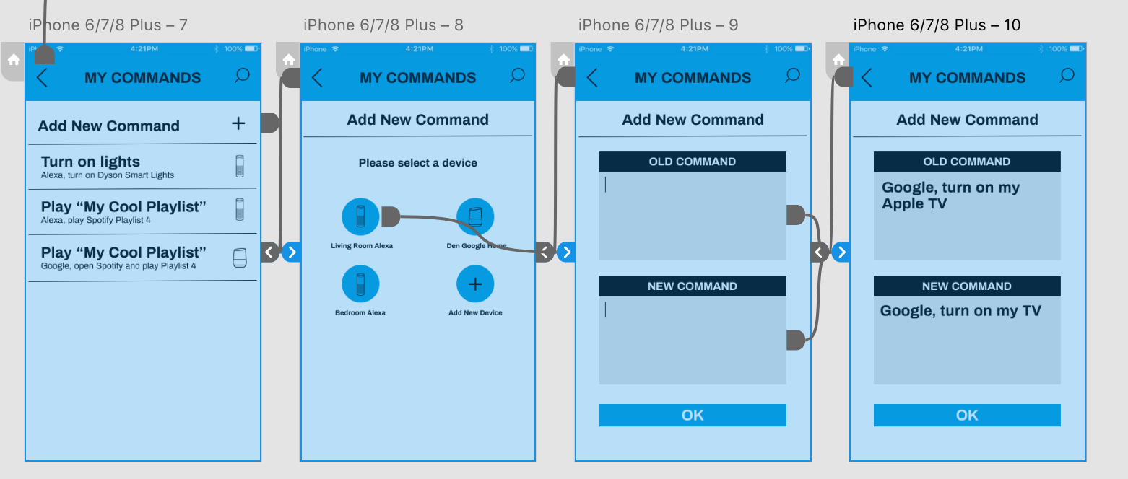
Medium-Fi Task Flow

Slide 13
Changes from Low-Fi Prototype
Took out Old and New tags
Added device icons
Put devices on new page and in grid format
Why? Focus users’ attention
Notes:
We took out the old and new tags, instead making the new command big and bold, with the old command in smaller text. We did this people we feel that users want to focus more on their new commands.
We added device icons so the users can associate the names of their devices with what they look like.
We added devices in a grid format on a new page instead of having a dialog box, because we thought it would be better to create a new page with this information.

Slide 14
Task 3: Look up history (simple)
Look up the ingredients in the recipe you used the Living Room Alexa to make last Monday

Slide 15
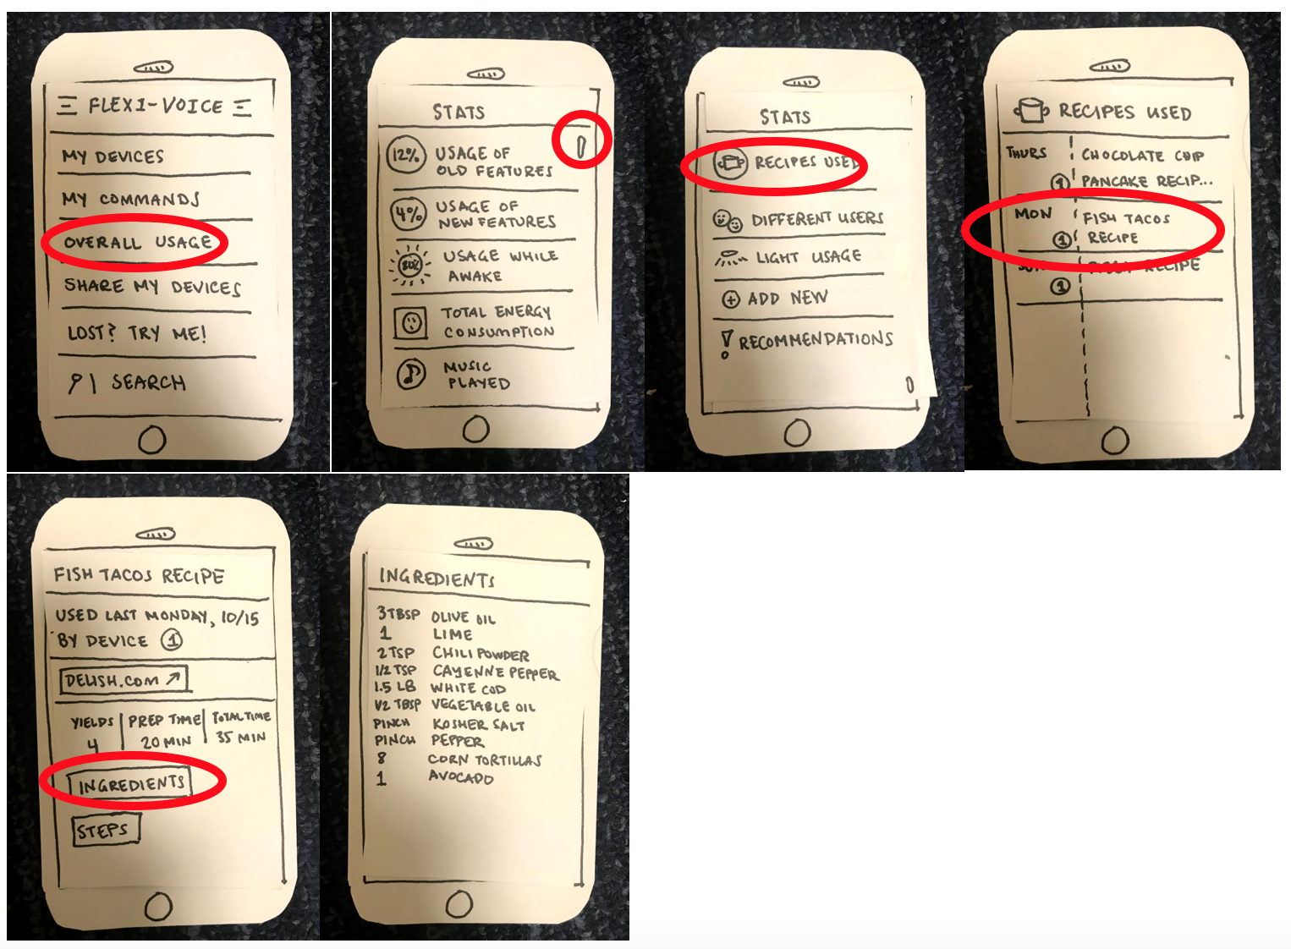
Old Interface

Slide 16
New Interface

Slide 17
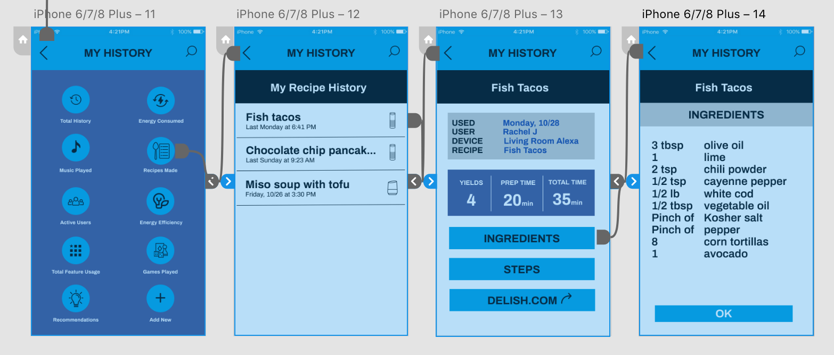
Medium-Fi Task Flow

Slide 18
Changes from Low-Fi Prototype
Changed Overall Usage to My Usage History
Got rid of scrolling
Changed Recipes Used to My Recipe History, and removed date column
Why? Make headings clearer and condense info
Notes:
We changed the Overall Usage button to be labeled My Usage History based on feedback from our usability testing.
We got rid of the scrolling on the main My History page in favor of using icons and putting everything on one screen. We did this because of feedback from our usability testing. One of our participants didn’t realize they could scroll down the page and therefore missed the correct button.
We changed Recipes Used to My Recipe History in order to go along with our use of history in related pages. We also removed the date column in favor of a time and day under the recipe itself, which then brings more attention to the recipe rather than the day.

Slide 19
Prototype Overview
Figma
What helped:
We were able to collaborate on the design in real time
It was easy to change colors and add effects to images
What didn’t help:
Interface wasn’t intuitive
Sometimes hard to move elements around
Would’ve like pre-made/pre-sized elements to insert

Slide 20
Prototype Overview
Adobe XD
What helped:
Easy to link from a button to the next screen
Easy to share
Voice-interactive feature
What didn’t help:
Had to add transparent boxes (invisible buttons) to have multiple voice triggers for one screen

Slide 21
Limitations
We had six tasks for our low-fi usability testing and had to narrow them down to three.
Left out “Call a Lyft” task (thought it was too simple)
Left out “Look up daily usage task” (thought other tasks would be better to put in our medium-fi prototype)
Left out “Add Garage Google” task (thought it was too complex to show in this prototype)

Slide 22
Wizard of Oz
Voice: responses to voice are simulated
Task 2:
Old and new commands field get filled with example commands
Task 1:
After clicking on contact, the app shows that you’ve sent a text to this person

Slide 23
Hard-Coded Features
This week’s usage on main screen (to show a week’s usage stats)
Personalized commands (to show an example of what typical commands would look like)
Device list (so it would look like the person has devices)
Old & new command fields (to show an example of a command pair)

Slide 24
More Hard-Coded Features
Sharing History (to show what sharing history looks like)
Contact List (so user can continue to next screen)
List of recipes and related stats (to demonstrate the search for recipe history task)

Slide 25
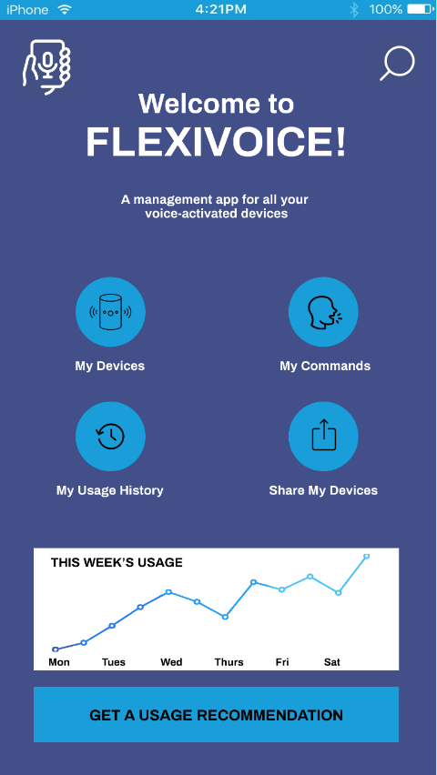
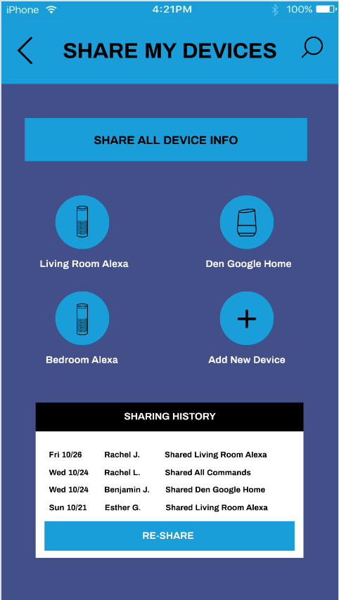
Additional Prototype Screenshots
Home Page
Task 1

Slide 26
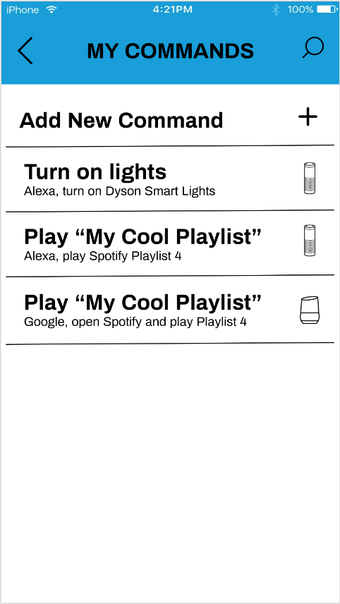
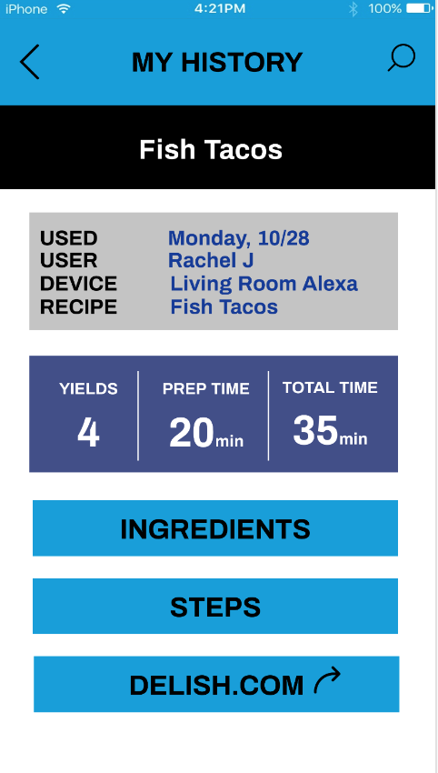
Additional Prototype Screenshots
Task 2
Task 3

